Slide 1
Data Structures and Algorithms (CCE 221)
By
Dr : Asmaa Aly Hagar

Slide 2
Course Academic Calendar
Week Num | Date | Content
Week1 | 24/9/2025 | Introduction to Data Structures + Mathematics Review + Review of Concepts of ‘C++’
Week2 | 01/10/2025 | Sparse Matrix, Concepts of Class, and Analysis of Algorithms
Week3 | 08/10/2025 | Linked Lists
Week4 | 15/10/2025 | Stack
Week5 | 22/10/2025 | Queue
Week6 | 29/10/2025 | Trees Part1
Week7 | 05/11/2025 | Free
Week8 | 12/11/2025 | Midterm
Week9 | 19/11/2025 | Trees Part2
Week10 | 26/11/2025 | AVL Trees
Week11 | 03/12/2025 | Priority Queues and Heaps
Week12 | 10/12/2025 | Graph
Week13 | 17/12/2025 | Searching and Sorting
 |  | Hashing

Slide 3
Lecture7

Slide 4
Contents of the Lecture
Binary Tree Traversals
Generic Trees
Expression Tree
Threaded Binary Tree
XOR Trees
Binary Search Tree
Decision Tree
Red Black Tree
Huffman Tree

Slide 5
Binary Tree Traversals
In order to process trees, we need a mechanism for traversing them.
The process of visiting all nodes of a tree is called tree traversal.
As we have already seen in linear data structures (like linked lists, stacks, queues, etc.), the elements are visited in sequential order. But, in tree structures there are many different ways.
Tree traversal is like searching the tree, except that in traversal the goal is to move through the tree in a particular order. In addition, all nodes are processed in the traversal but searching stops when the required node is found.

Slide 6
Traversal Possibilities
LDR: Process left subtree, process the current node data and then process right subtree
LRD: Process left subtree, process right subtree and then process the current node data
DLR: Process the current node data, process left subtree and then process right subtree
DRL: Process the current node data, process right subtree and then process left subtree
RDL: Process right subtree, process the current node data and then process left subtree
RLD: Process right subtree, process left subtree and then process the current node data

Slide 7
Classifying the Traversals
The classification is based on the order in which current node is processed. That means, if we are classifying based on current node (D) and if D comes in the middle, then it does not matter whether L is on left side of D or R is on left side of D.
Due to this, the total 6 possibilities are reduced to 3 and these are:
Preorder (DLR) Traversal
Inorder (LDR) Traversal
Postorder (LRD) Traversal
There is another traversal method which does not depend on the above orders and it is:
Level Order Traversal: This method is inspired from Breadth First Traversal (BFS of Graph algorithms).
Tree traversal can be performed in two different ways such as
BY USING RECURSION
WITHOUT USING RECURSION (using Stack)

Slide 8
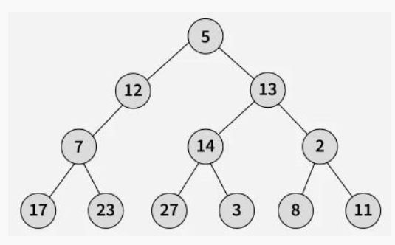
Level Order Traversal
Level Order Traversal technique is a method to traverse a Tree such that all nodes present in the same level are traversed completely before traversing the next level.
Level order traversal is defined as follows:
Visit the root.
While traversing level l, keep all the elements at level l+ 1 in queue.
Go to the next level and visit all the nodes at that level.
Repeat this until all levels are completed.
Level Order: 5 12 13 7 14 2 17 23 27 3 8 11

Slide 9
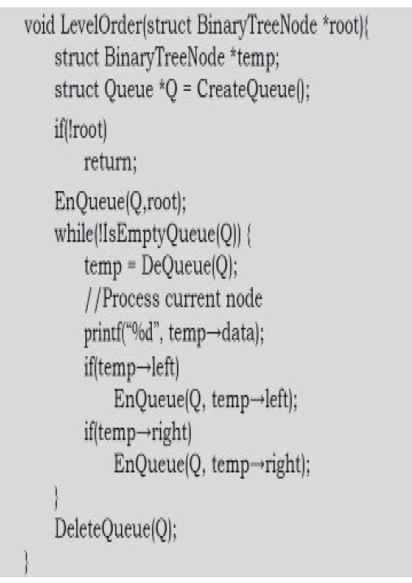
Level Order Traversal
5
12
13
7
14
2
17
23
27
3
8
11
Level Order: 5 12 13 7 14 2 17 23 27 3 8 11

Slide 10
Example
Preorder: 1 2 4 5 3 6 7
Inorder: 4 2 5 1 6 3 7
Postorder: 4 5 2 6 7 3 1
Level Order: 1 2 3 4 5 6 7

Slide 11
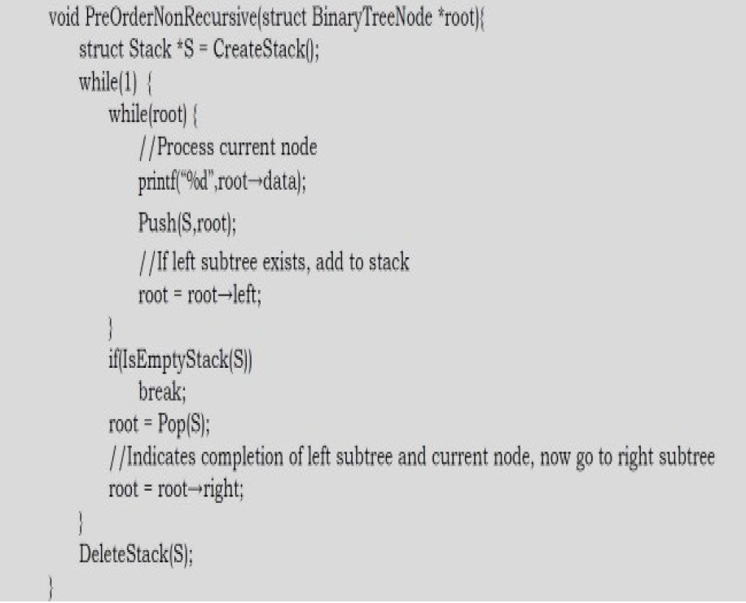
Non-Recursive Preorder Traversal
7
6
3
5
4
2
1
Root: 1→ 2 → 4 → Null → 4→Null →2 →5 → Null →5 →Null →1 →3 →6 →Null →6 →Null →3 →7 →Null →7 →Null
Preorder: 1 2 4 5 3 6 7

Slide 12
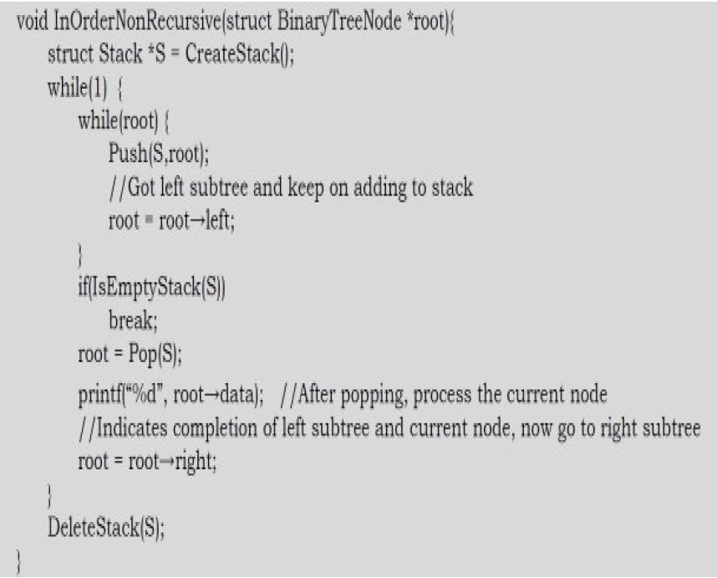
Non-Recursive Inorder Traversal
7
6
3
5
4
2
1
Root: 1→ 2 → 4 → Null → 4→Null →2 →5 → Null →5 →Null →1 →3 →6 →Null →6 →Null →3 →7 →Null →7 →Null
Inorder: 4 2 5 1 6 3 7

Slide 13
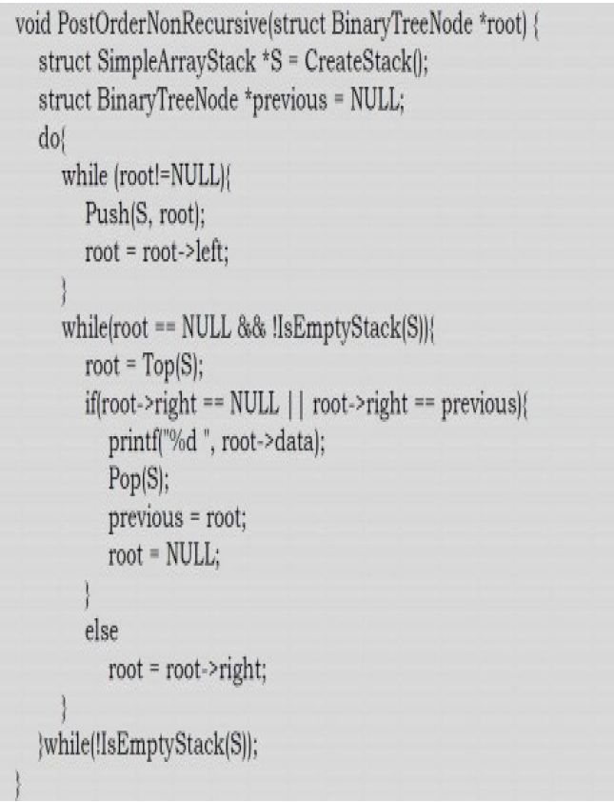
Non-Recursive Postorder Traversal
7
6
3
5
4
2
1
Root: 1→ 2 → 4 → Null → 4→Null →2 →5 → Null →5 →Null →2→Null→1 →3 →6 →Null →6 →Null →3 →7 →Null →7 →Null→3→Null→1→Null
Previous: 4→5→2→6→7→3→1
Postorder: 4 5 2 6 7 3 1

Slide 14
Generic Trees (N-ary Trees)
In the previous section, we discussed binary trees where each node can have a maximum of two children and these are represented easily with two pointers.
But suppose if we have a tree with many children at every node and also if we do not know how many children a node can have, how do we represent them?
For example, consider the tree shown below.

Slide 15
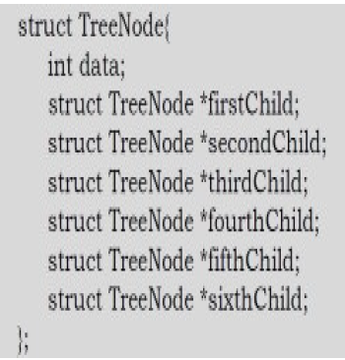
How do we represent the tree?
In the above tree, there are nodes with 6 children, with 3 children, with 2 children, with 1 child, and with zero children (leaves).
To present this tree we have to consider the worst case (6 children) and allocate that many child pointers for each node.
Problems
Since we are not using all the pointers in all the cases, there is a lot of memory wastage.
Another problem is that we do not know the number of children for each node in advance.
In order to solve these problems, we need a representation that minimizes the wastage and also accepts nodes with any number of children.

Slide 16
Representation of Generic Trees
Since our objective is to reach all nodes of the tree, a possible solution to this is as follows:
At each node link children of same parent (siblings) from left to right.
Remove the links from parent to all children except the first child.
This representation is sometimes called first child/next sibling representation.

Slide 17
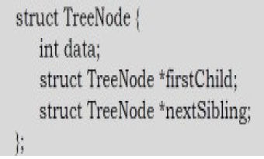
Representation of Generic Trees
C
D
H
Note: Since we are able to convert any generic tree to binary representation; in practice we use binary trees. We can treat all generic trees with a first child/next sibling representation as binary trees.

Slide 18
Types of Binary Tree
There are different types of BINARY trees are found but some of them which are frequently used are
Expression Tree
Threaded Binary Tree
XOR Trees
Binary Search Tree
Decision Tree
Red Black Tree
Huffman Tree
B Tree and B+ Tree
Balanced Binary Trees [BBT]
Height Balanced Tree (AVL Tree)
Heap Tree

Slide 19
Expression Tree
An expression tree is a Binary Tree which stores/represents the mathematical (arithmetic) expressions.
The leaves of an expression tree are operands, such as constants or variable names and all the internal nodes are the operators.
An expression tree will be always a binary tree because an arithmetic expression contains either binary operators or unary operators.
Formally we can define an expression Tree as a special kind of binary tree in which:
Each leaf is an operand. Examples: a, b, c, 6, 100
The root and internal nodes are operators. Examples: +, -,*, /, ^
Subtrees are subexpressions with the root being an operator.

Slide 20
Examples
f(A,B,C) * (Sin(D) - Log(E * F! ))
(A + B * C) / D
*
f
-
A
B
C
Sin
Log
D
*
E
!
F

Slide 21
Threaded Binary Tree
In earlier sections, we have seen that, preorder, inorder and postorder binary tree traversals used stacks and level order traversals used queues as an auxiliary data structure.
In this section we will discuss new traversal algorithms which do not need both stacks and queues. Such traversal algorithms are called threaded binary tree traversals or stack/queue – less traversals.
Issues with Regular Binary Tree Traversals
The storage space required for the stack and queue is large.
The majority of pointers in any binary tree are NULL. For example, a binary tree with n nodes has n + 1 NULL pointers and these were wasted.
It is difficult to find successor node (preorder, inorder and postorder successors) for a given node.

Slide 22
Threaded Binary Tree
To solve these problems, one idea is to store some useful information in NULL pointers. If we observe the previous traversals carefully, stack/ queue is required because we have to record the current position in order to move to the right subtree after processing the left subtree. If we store the useful information in NULL pointers, then we don’t have to store such information in stack/queue.
The binary trees which store such information in NULL pointers are called threaded binary trees.
From the above discussion, let us assume that we want to store some useful information in NULL pointers. The next question is what to store?
The common convention is to put predecessor/successor information. That means, if we are dealing with preorder traversals, then for a given node, NULL left pointer will contain preorder predecessor information and NULL right pointer will contain preorder successor information. These special pointers are called threads.

Slide 23
Classifying Threaded Binary Trees
The classification is based on whether we are storing useful information in both NULL pointers or only in one of them.
If we store predecessor information in NULL left pointers only, then we can call such binary trees left threaded binary trees.
If we store successor information in NULL right pointers only, then we can call such binary trees right threaded binary trees.
If we store predecessor information in NULL left pointers and successor information in NULL right pointers, then we can call such binary trees fully (complete) threaded binary trees or simply threaded binary trees.

Slide 24
Left Threaded Binary Tree
a
Inorder: d b h e a f c i g
c
b
f
g
d
e
Here all the left pointers are attached with its inorder predecessor.
i
h

Slide 25
Right Threaded Binary Tree
a
Inorder: d b h e a f c i g
c
b
f
g
d
e
Here all the right pointers are attached with its inorder successor).
i
h

Slide 26
fully (Complete) Threaded Binary Tree
a
Inorder: d b h e a f c i g
c
b
Here all the left pointers are attached with its inorder predecessor and all the right pointers are attached with its inorder successor).
f
g
d
e
i
h

Slide 27
Types of Threaded Binary Trees
Based on above discussion we get three representations for threaded binary trees.
Preorder Threaded Binary Trees: NULL left pointer will contain PreOrder predecessor information and NULL right pointer will contain PreOrder successor information.
Inorder Threaded Binary Trees: NULL left pointer will contain InOrder predecessor information and NULL right pointer will contain InOrder successor information.
Postorder Threaded Binary Trees: NULL left pointer will contain PostOrder predecessor information and NULL right pointer will contain PostOrder successor information.

Slide 28
Right Threaded Binary Tree
We can implement a right in threaded binary tree using arrays by distinguishing threads from ordinary pointers.
Threads are denoted by negative numbers , when ordinary pointers are denoted by positive integers .
To implement a right in threaded binary tree using dynamic memory allocation, an extra 1 bit logical field, rthread , is used to distinguish threads from ordinary pointers. If a right pointer of a node is threaded, then the rthread = TRUE otherwise FALSE.
Inorder: D G B H E I A F J C

Slide 29
XOR Trees
This concept is similar to memory efficient doubly linked lists of Linked Lists. Also, like threaded binary trees this representation does not need stacks or queues for traversing the trees.
This representation is used for traversing back (to parent) and forth (to children) using ⊕ operation.
To represent the same in XOR trees, for each node below are the rules used for representation:
Each nodes left will have the ⊕ of its parent and its left children.
Each nodes right will have the ⊕ of its parent and its right children.
The root nodes parent is NULL and also leaf nodes children are NULL nodes.

Slide 30
XOR Trees
The major objective is the ability to move to parent as well to children. Now, let us see how to use this representation for traversing the tree.
For example, if we are at node B and want to move to its parent node A, then we just need to perform ⊕ on its left content with its left child address (we can use right child also for going to parent node).
Similarly, if we want to move to its child (say, left child D) then we have to perform ⊕ on its left content with its parent node address.
One important point that we need to understand about this representation is: When we are at node B, how do we know the address of its children D? Since the traversal starts at node root node, we can apply ⊕ on root’s left content with NULL. As a result we get its left child, B. When we are at B, we can apply ⊕ on its left content with A address.

Slide 31
Binary Search Trees
Why Binary Search Trees?
In previous sections, we have discussed different tree representations and in all of them we did not impose any restriction on the nodes data. As a result, to search for an element we need to check both in left subtree and in right subtree. Due to this, the worst case complexity of search operation is O(n).
In this section, we will discuss another variant of binary trees: Binary Search Trees (BSTs). As the name suggests, the main use of this representation is for searching. In this representation we impose restriction on the kind of data a node can contain. As a result, it reduces the worst case average search operation to O(logn).

Slide 32
Binary Search Trees
A Binary Search Tree is a binary tree, which is either empty or satisfies the following properties :
Every node has a value and no two nodes have the same value (i.e., all the values are unique).
If there exists a left child or left sub tree then its value is less than the value of the root.
The value(s) in the right child or right sub tree is larger than the value of the root node
BST
Not BST

Slide 33
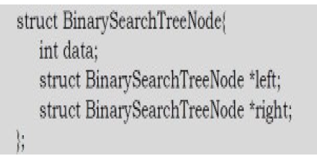
Binary Search Tree Declaration
There is no difference between regular binary tree declaration and binary search tree declaration.
The difference is only in data but not in structure. But for our convenience we change the structure name as:

Slide 34
Operations on Binary Search Trees
The operations performed on binary tree can also be applied to Binary Search Tree (BST).
But in this section, we discuss few other primitive operators performed on BST
Inserting an element in BST
Searching for an element in BST
Deleting an element from BST
Find Minimum element in BST
Find Maximum element in BST
Sorting the elements of BST
Note: Since root data is always between left subtree data and right subtree data, performing inorder traversal on binary search tree produces a sorted list.

Slide 35
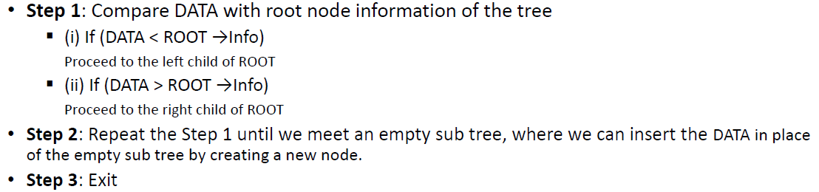
Inserting an element in BST
Inserting a node in to a tree is achieved by performing two separate operations
The tree must be searched to determine where the node is to be inserted.
Then the node is inserted into the tree.
Suppose a “DATA” is the information to be inserted in a BST.

Slide 36
Inserting an element in BST
Algorithm
NEWNODE is a pointer variable to hold the address of the newly created node.
DATA is the information to be pushed.

Slide 37
Searching for an element in BST
Searching a node was part of the operation performed during insertion.
Algorithm

Slide 38
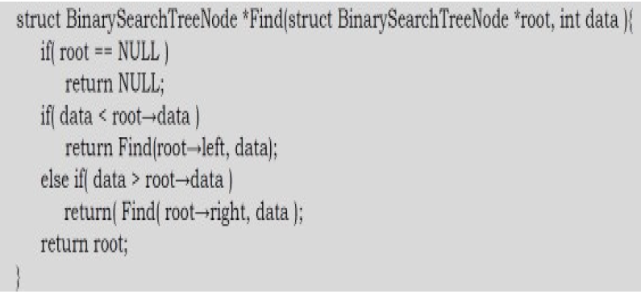
Recursive Algorithm

Slide 39
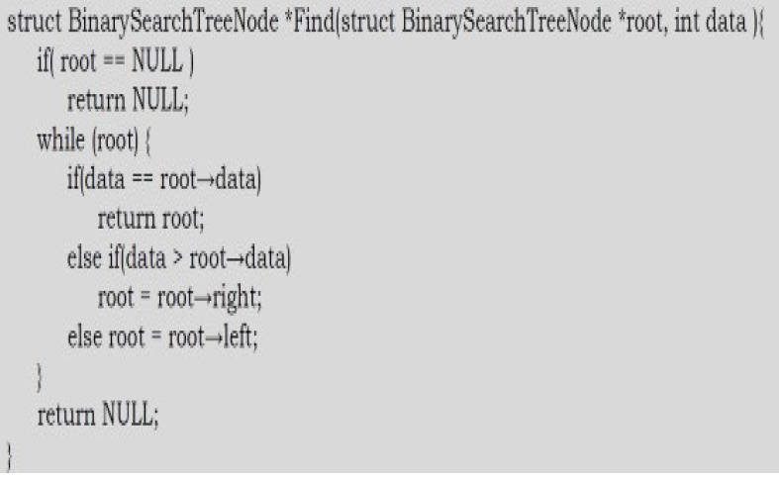
Non Recursive Algorithm

Slide 40
Deleting an element in BST
First search and locate the node to be deleted.
Then any one of the following conditions arises:
The node to be deleted has no children
The node has exactly one child (or sub tress, left or right sub)
The node has two children (or two sub tress, left and right sub)
Suppose the node to be deleted is N.
If N has no children, then simply delete the node and place its parent node by the NULL pointer.

Slide 41
Deleting an element in BST
If N has one child , check whether it is a right or left child .
If it is a right child , then find the smallest element from the corresponding right sub tree. Then replace the smallest node information with the deleted node.
If N has a left child, find the largest element from the corresponding left sub tree. Then replace the largest node information with the deleted node.
The same process is repeated if N has two children , i.e., left and right child. Randomly select a child and find the small/large node and replace it with deleted node. NOTE that the tree that we get after deleting a node should also be a binary search tree.

Slide 42
Deleting an element in BST
Example : Delete 75

Slide 43
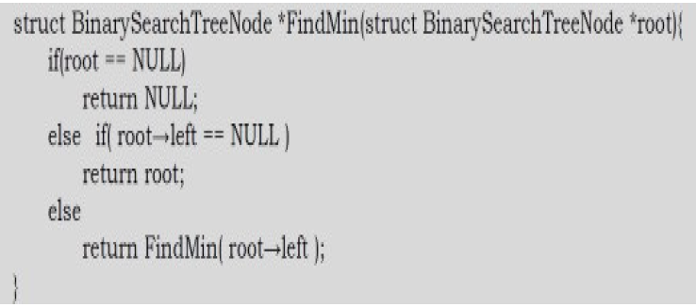
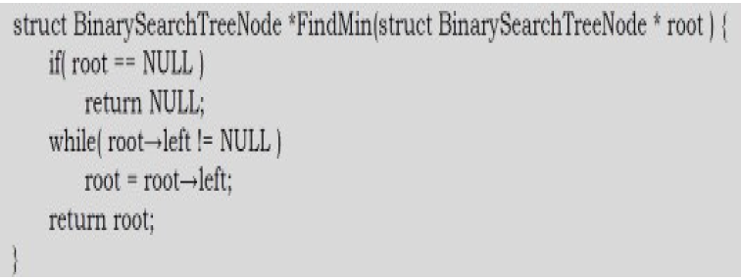
Finding Minimum Element in BST
In BSTs, the minimum element is the left-most node, which does not has left child. In the BST below, the minimum element is 4.
Non recursive algorithm

Slide 44
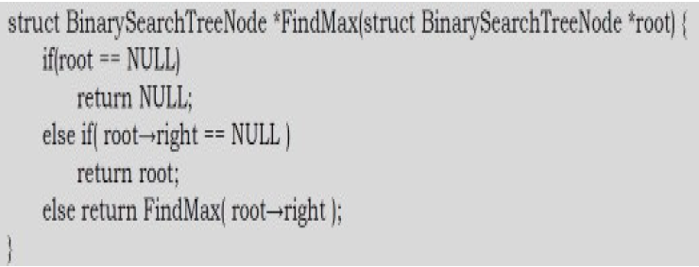
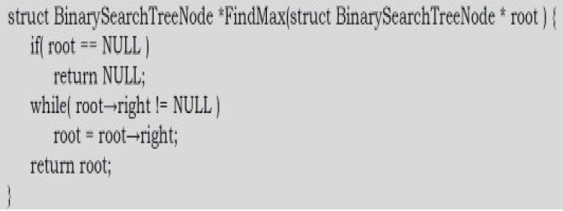
Finding Maximum Element in BST
In BSTs, the maximum element is the right-most node, which does not have right child. In the BST below, the maximum element is 16.
Non recursive algorithm

Slide 45
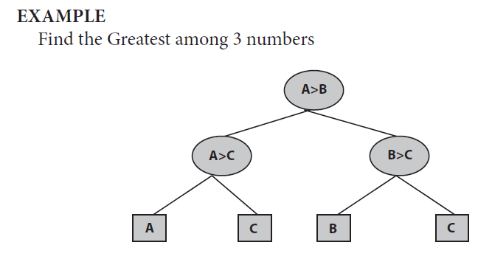
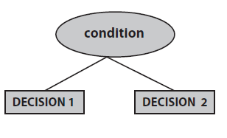
Decision Tree
A decision tree is a binary tree where a node represents some decision and edges emanating from a node represent the outcome of the decision. External nodes (leaves) represent the ultimate decisions.

Slide 46
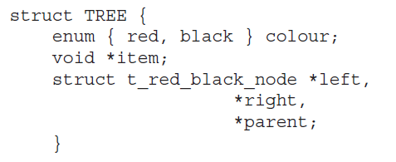
Red–Black Tree
A red-black tree is a binary search tree with one extra attribute for each node: the colour, which is either red or black. We also need to keep track of the parent of each node, so that a red-black tree’s node structure would be:
Each node has the following attributes:
Color
Key
leftChild
rightChild
parent (except root node)
For the purpose of this discussion, the NULL nodes which terminate the tree are considered to be the leaves and are coloured black.

Slide 47
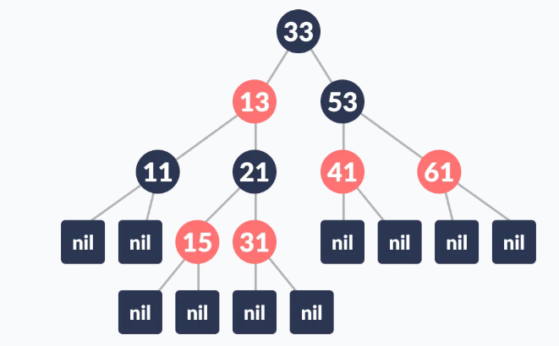
Red–Black Tree
Red-Black tree is a self-balancing binary search tree in which each node contains an extra bit for denoting the color of the node, either red or black.
A red-black tree satisfies the following properties:
Red/Black Property: Every node is colored, either red or black.
Root Property: the root is black
External Property: every leaf (NIL) is black
Internal Property: the children of a red node are black
Depth Property: For each node, any simple path from this node to any of its descendant leaf has the same black-depth (the number of black nodes).

Slide 48
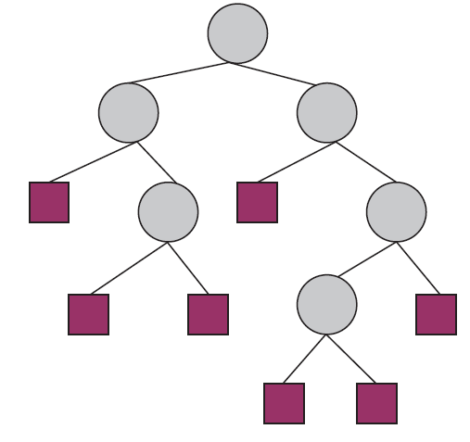
Huffman Tree
Generally, the HUFFMAN TREE concept is implemented based upon the concepts of extended binary tree.
In extended binary tree, every node has zero or two children. The nodes which have two children that is called as internal nodes and the node which have no children that is called as external node.
In every extended binary tree, the number of external nodes is more than the number of internal nodes.
Mathematically: External node = internal node + 1 ➔ i.e/ E = I+1
The external nodes are represented by the square brackets and the internal nodes are represented by the Circles.

Slide 49
Huffman Tree
The path length for any node is the number of minimum nodes traversed from root to that node.
The total length for internal and external nodes are :-
Path(I) = 0 + 1 + 2 + 1 + 2 + 3 = 9
Path(E) = 2 + 3 + 3 + 2 + 4 + 4 + 3 = 21
We can also get the total path length of external node as PATH(E) = PATH(I) + 2N Where N is the number of internal nodes.
Suppose each node having some weights then the weighted path length will be P = W1P1 + W2P2 + …………… + WNPN
W is the weight and P is the path length of an external node.

Slide 50
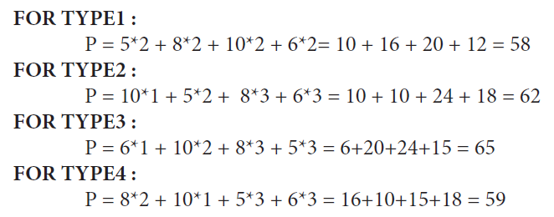
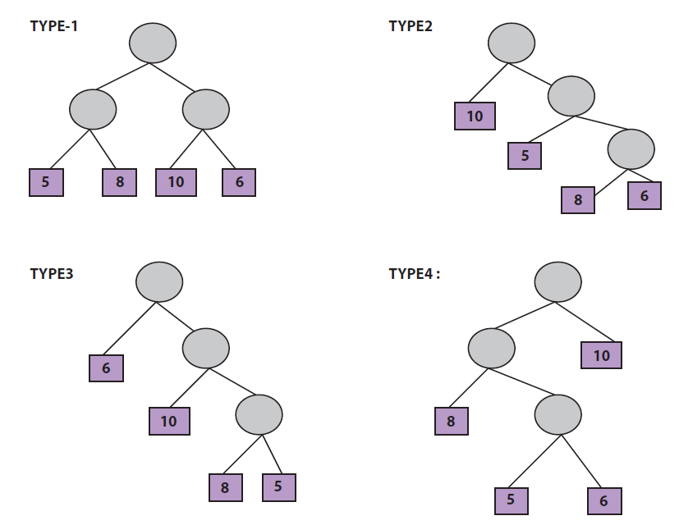
Huffman Tree
EXAMPLE: Let we will create different trees with 5, 8, 10, 6
From this example, we observe that different trees have different path lengths even if same type of trees.
So, problem arises to find the minimum weighted path length. This type of extended binary tree can be obtained by the Huffmann algorithm.

Slide 51
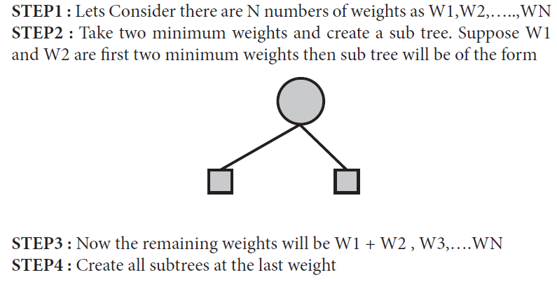
HUFFMAN ALGORITHM

Slide 52
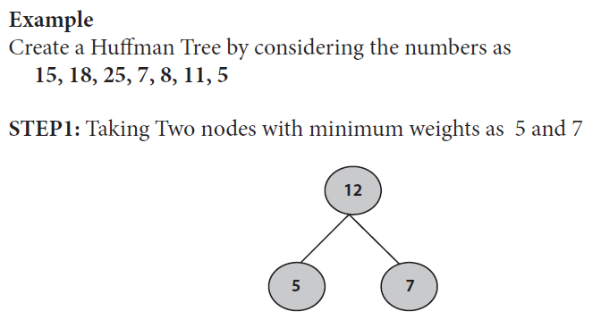
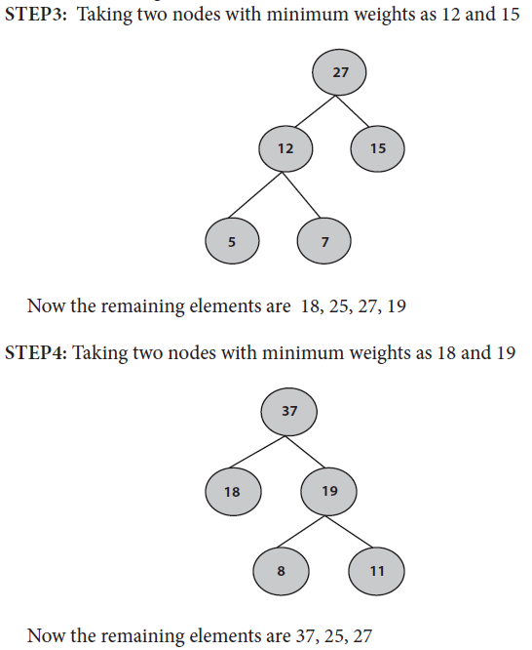
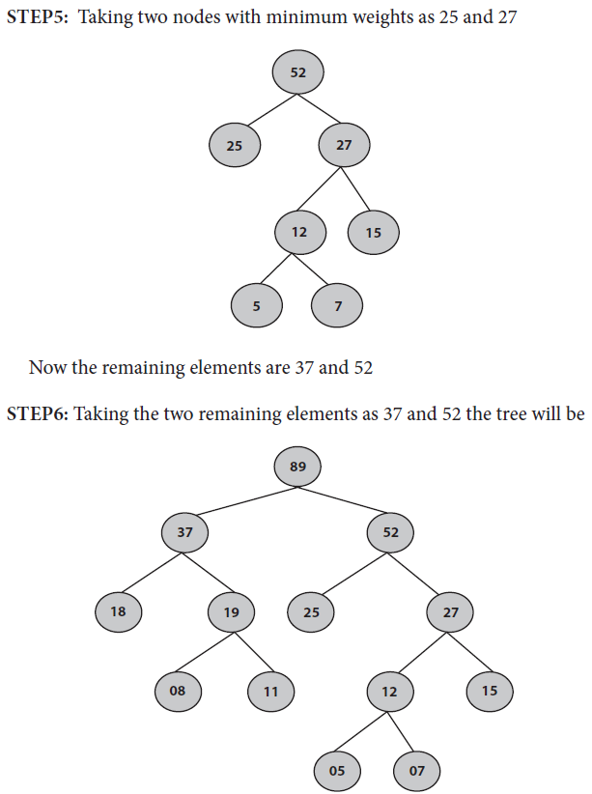
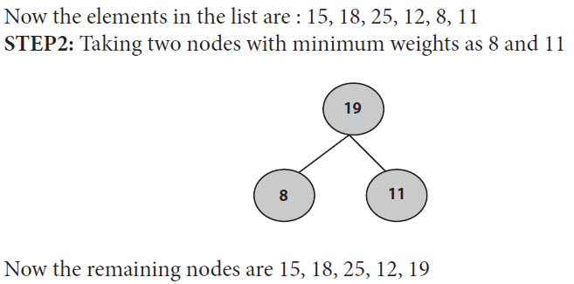
HUFFMAN ALGORITHM

Slide 53


